Slide 1

2nd Filtration Phase

Slide 2
Personal Information
Experience Background | Team Role | Phone Number | Email | Name | #
Embedded systems | Team Leader | 01156493884 | omniam200079@gmail.com | Omnia Mahmoud Ismail | 1
Embedded systems | Team member | 01067042473 | 01067042473m@gmail.com | Mohamed Mohsen Mansour | 2
Embedded systems | Team member | 01127153963 | waleed.ebrahem.19@gmail.com | Waleed Ebrahem Mohamed | 3
Embedded systems | Team member | 01200474980 | youssefdarwish50@gmail.com | Youssef Ahmed Hosny | 4
Embedded Testing | Team member | 01155100252 | Halam2146@gmail.com | Hala Mohamed Hemaida | 5

Slide 3

Project Description
Problem Statement Identify the Problem that your project solves
Water pollution presents significant challenges when it comes to monitoring and assessing its impact on aquatic environments. One of the main difficulties lies in the vastness and complexity of water systems, making it challenging to collect comprehensive data. Additionally, pollutants can originate from various sources, both point and non-point, making it difficult to pinpoint their exact origins. Furthermore, the dynamic nature of water bodies, including currents and tides, can disperse pollutants, making their detection and measurement even more challenging. Inadequate monitoring infrastructure and limited resources further hinder the timely and accurate assessment of water pollution. Overcoming these difficulties requires the development of advanced monitoring technologies, enhanced collaboration between stakeholders, and increased investment in robust monitoring systems to ensure the protection and conservation of our water resources.
Solution Description Novelty and Features that the project introduces
Solution: using boat which will be our way to monitor quality of water which has feature as: -Using not expensive sensors to achieve monitoring. -Check water quality remotely. -Achieve Real Time and Easy Information. -Quality Classification According to User’s needs. -Using MPU and GPS Sensors to Navigate. -Communicating with mobile through Bluetooth Waves. -Autonomous Moving by just one Click. -Holding Water Sensors. -Using PID Algorithm.

Slide 4
Project Description
Deliverables The Project's Final Outcome: (HW Device - SW Packages - Simulation – Machine)
ASWQM Video
Impact of the Solution The Project Impact on the Community/Market
Our project will change world of water monitoring by: -It’s easier to test by boats. -cost of testing cheaper than traditional test -factories can use our project, -this project not has bad effect on human by not make tester face maybe dangerous (polluted water)to human health. -save time and save result on mobile app which is user friendly.

Slide 5
Business Plan
Market Research Summarize the market research conducted, including the size of the market, and target audience. Highlight any trends or opportunities that support the viability of the project.
Market Size: The market size for water quality monitoring can vary depending on the specific application and geographic region. Water quality monitoring is conducted in various sectors, including environmental monitoring, industrial processes, agriculture, and public health. The market size could range from local applications, such as monitoring a specific body of water, to larger-scale applications covering multiple regions or countries. Target Audience: The target audience for a project involving a boat with water quality sensors can be diverse and depend on the purpose of the monitoring. Potential stakeholders may include government agencies responsible for environmental regulation, water treatment facilities, research institutions, environmental consulting firms, and industries relying on clean water sources. Trends and Opportunities: There are several trends and opportunities that support the viability of a project focusing on water quality monitoring: Increasing Environmental Concerns: Growing awareness about the importance of water quality and its impact on ecosystems, human health, and industries has led to an increased demand for monitoring solutions. Regulatory Compliance: Governments and regulatory bodies worldwide are implementing stricter regulations and guidelines related to water quality. This creates opportunities for companies providing water monitoring solutions to help meet compliance requirements.

Slide 6
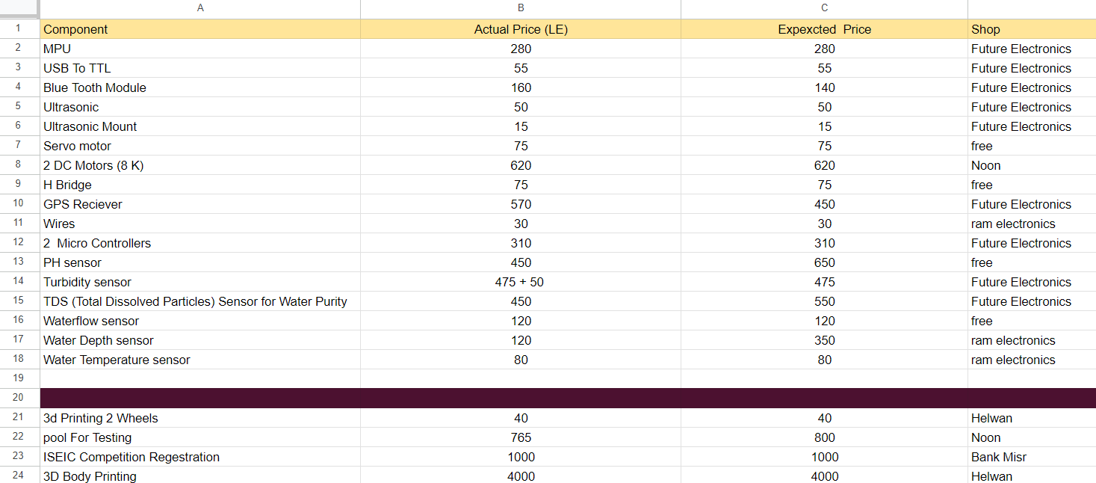
Business Plan
Financial Projections Financial Goals - Budget in Detail - Future Plans
Financial Goals: covering the initial investment, maintaining and upgrading sensor equipment, funding ongoing operational expenses, and ensuring long-term sustainability. Define objectives related to revenue generation, if applicable, such as monetizing collected data or offering consulting services based on the insights obtained. Consider long-term financial goals beyond the project, such as saving for future expansions or diversifying revenue streams. Budget in details:

Slide 7
Business Plan
Future Plans: -Add other sensors which will make the result more accurate, hence classification range increase, serve more sorts of customers and that will lead to more revenue. -Add more boats so the range of services will be larger. -Replace communication component with communication component cover more range.
Comparison to Competitors What differentiates your solution from other Competitors and mention aspects
Traditionally, water quality monitoring relies on manual systems of data collection sampling. Sensors are placed at stations to record data, with a sample taken from each and sent to a laboratory for analysis. It is time consuming, costly and inefficient, creating difficult conditions to compare or assess the various water quality parameters. Another way to monitor called regional approach used to monitor individual lakes and rivers instead of building station, this way takes sample of water and send to laboratory, this way still slow and can’t recognize the emergency quickly.

Slide 8
Business Model Canvas |  |  | Team: ASWQM
Key Partners 1- Sensor Manufacturers 2-Technology Providers 3- Water Quality Monitoring Stations | Key Activities 1- Hardware Development 2-Software Development 3-Data Transmission & Analysis | Value Propositions -Advanced Water Quality Monitoring -Remote Monitoring and Control -Cost-Effective Solution -User friendly Visualization | Customer Relationships -Consultative Approach -Ongoing Support | Customer Segments 1-Environmental Agencies 2-Households 3-Businesses 4-Water Resource Managers 5-Research Institutions 6- Environmental Minstry
 |  |  | Channels -Direct Sales -Boat Booking -Online Platforms(Mobile apps)
 | Key Resources -Hardware Components -Software Systems
Cost Structure -Component Costs -Operations and Maintenance costs -Technical work costs -Research and Development |  |  | Revenue Streams -Product Sales -Boat Booking -Service Contracts

Slide 9
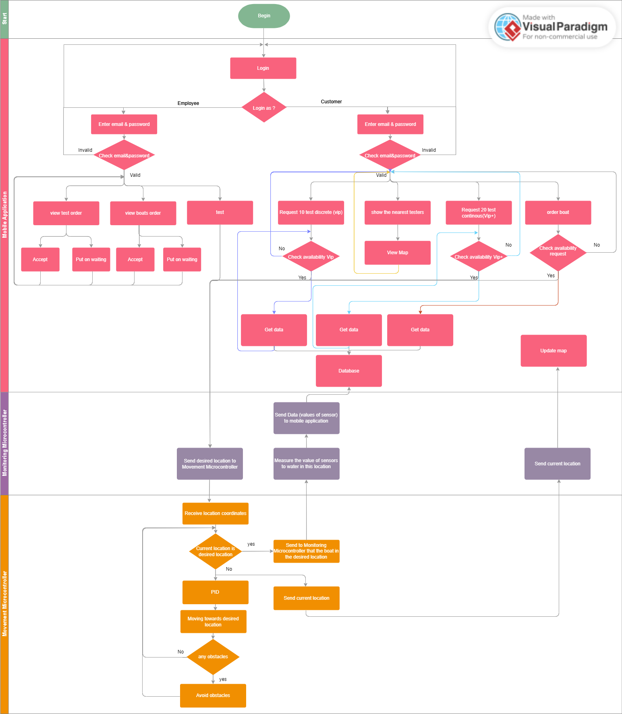
Technical Approach
System Design
1.System Architecture and Data Flow

Slide 10
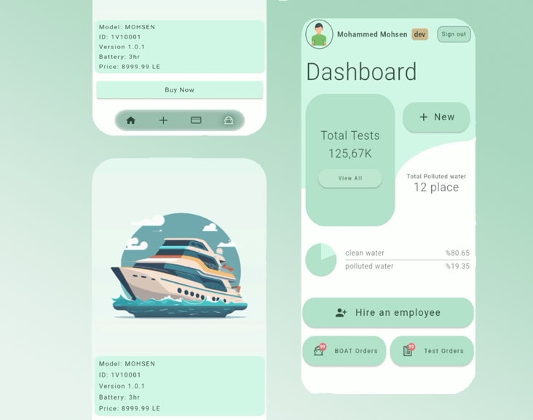
Technical Approach
2.User interfaces if any

Slide 11
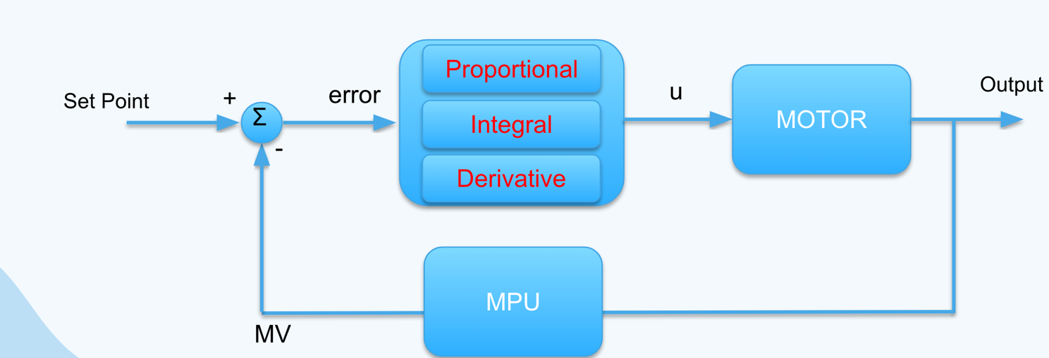
Technical Approach
System Design
3.Algorithmic components if any
Applying PID algorithm on the MPU sensor’s reading (feedback) to navigate the boat to the destination.
4.Innovative aspects of the design
Autonomous Navigation Remote Monitoring and Control Sensors Integration Data Transmission and Analysis Data Visualization and Analytics Classification of Water quality

Slide 12
Technical Approach
Hardware and software platforms
Challenges How to overcome them, and how it affects the overall project
Sensor Calibration and Maintenance -> by testing in different conditions and validating against reference standards. Power Management -> using two powering units one for motion components & one for the monitoring components. Data Transmission and Connectivity -> using a wide range Bluetooth module to send sensors reading to mobile app. Boat Navigation -> using GPS module to detect starting coordinates and destination coordinates then use MPU sensor to make boat reach destination also using ultrasonic sensor to make boat avoid in obstacles in the way
Hardware Platforms | Software Platforms
Microcontrollers (Atmega 32) | Atmel Studio
Sensors ( pH, TDS, Turbidity, Temperature ) | Flutter
GPS Module
Bluetooth Communication Module

Slide 13
Technical Approach
System Implementation
Hardware and software development tools, languages, etc. Modules/components bought from external sources (e.g., open source, licensed commercial/trial products, etc.)
Hardware Components : 2 MCU (Atmega32), pH Sensor, Total Dissolved Solids Sensor, Turbidity Sensor, Water Temperature Sensor, Bluetooth Module, GPS Module, MPU Sensor, 2 Motors, H-Bridge, Ultrasonic Sensor] Software Development tools : Atmel Studio IDE, Flutter Framework Programming Languages: C, Embedded C for MCU and sensors configuration Dart for the mobile app
Innovative aspects of the implementation
Autonomous Mission Planning and Optimization Sensor Integration and Calibration Data Processing and Analysis Collaborative Monitoring Networks User-friendly Data Visualization and Reporting

Slide 14
Technical Approach
System Implementation
Current Progress
The Monitoring Section is completed and tested several times in various conditions. The Mobile Application that display the monitoring sensors reading is completed and tested several times in various conditions. The Motion Section is working but still needs some modifications.
Availability Plan
the project is almost ready but needs some modifications: wifi instead of bluetooth for further range, stm32 instead of atmega32 for higher processing, making a product line connecting multiple devices together and use cloud computing to upload and process data.
Contingency plan and risk plan
there may appear some risks in the future: 1- fund risk: more than one device may require almost more than 2000 LE. 2- components risk:water sensors may need to be imported if not available or more expensive. 3- motion quality risk: if weather changes are not expected especially outside Egypt.

